Slide 1
Initial Design for Conflict Entity Class
Daniel Ablog and Al Creigh
September 27, 2013

Slide 2
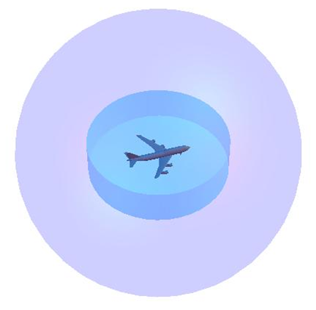
Overview
Objective to simulate conflict between objects in 3D space
Inherits positions data from vehicle class
Cylinder represents how FAA ATC partitions airspace

Slide 3
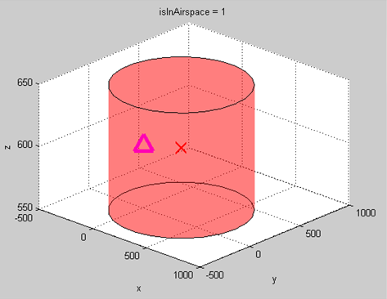
Tests
Validate methods created in the Conflict Entity Class
Functionality of the class in various corner and edge cases

Slide 4
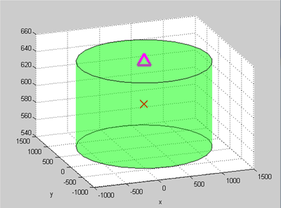
Example Test Cases
Ensure a client/user can instantiate a conflict entity.
Make sure that the plot method functions as expected.

